Slide 1

CSCE883 Machine Learning
Lecture 6 Neural Networks and Deep Learning
Jianjun Hu
Department of Computer Science & Engineering
University of South Carolina

Slide 2
Artificial Neural Networks
What are Neural Networks?
Biological Neural Networks
ANN – The basics
Feed forward net
Training-Back propagation algorithm
Example – Voice recognition
Applications – Feed forward nets
Recurrency
Elman nets
Hopfield nets
Central Pattern Generators
Conclusion

Slide 3
What are Neural Networks?
Models of the brain and nervous system
Highly parallel
  Process information much more like the brain than a serial computer
Learning
Very simple principles
Very complex behaviours
Applications
  As powerful problem solvers
  As biological models

Slide 4
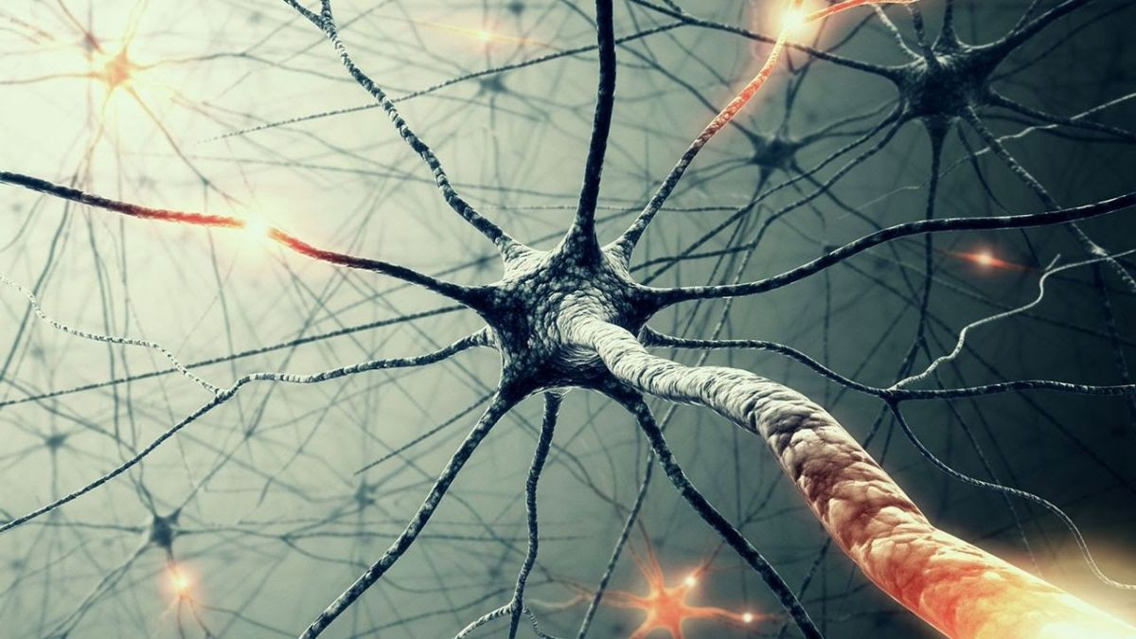
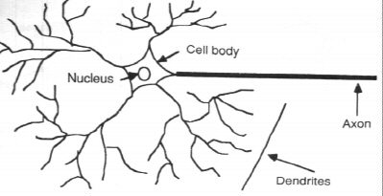
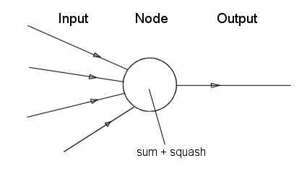
Neurone vs. Node

Slide 5
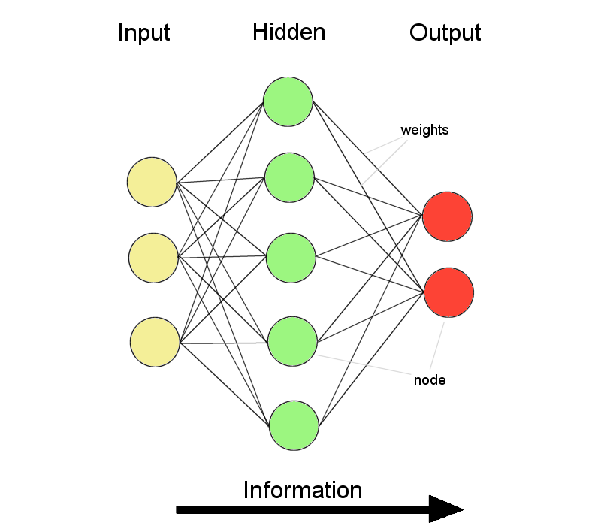
ANNs – The basics
ANNs incorporate the two fundamental components of biological neural nets:
Neurones (nodes)
Synapses (weights)

Slide 6
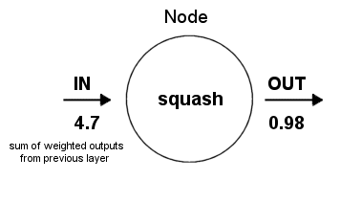
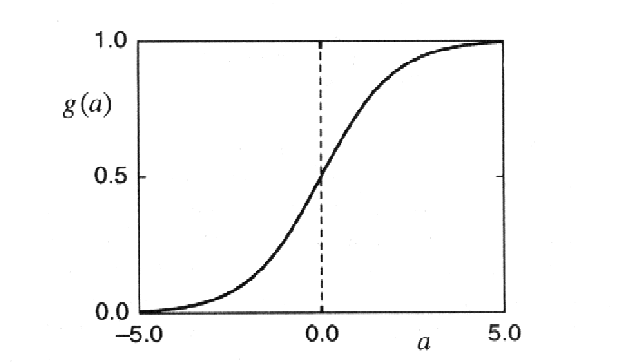
Structure of a node:
Squashing function limits node output:

Slide 7
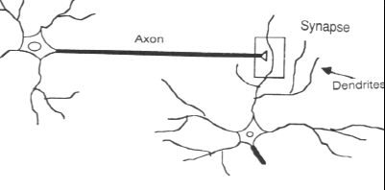
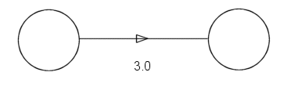
Synapse vs. weight

Slide 8
Feed-forward nets
Information flow is unidirectional
  Data is presented to Input layer
  Passed on to Hidden Layer
  Passed on to Output layer
Information is distributed
Information processing is parallel
Internal representation (interpretation) of data

Slide 9
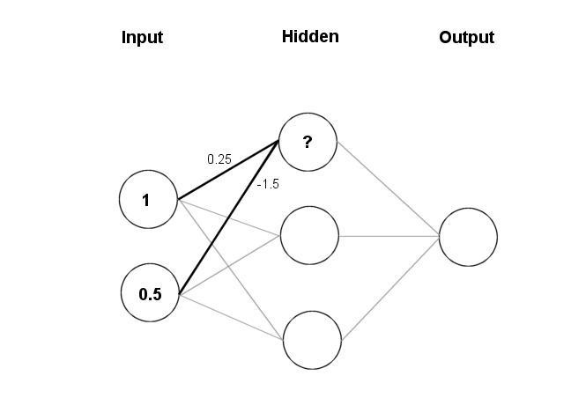
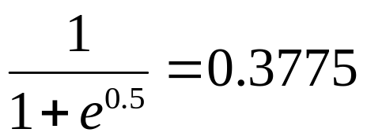
Feeding data through the net:
(1 × 0.25) + (0.5 × (-1.5)) = 0.25 + (-0.75) = - 0.5
Squashing:

Slide 10
Data is presented to the network in the form of activations in the input layer
Examples
  Pixel intensity (for pictures)
  Molecule concentrations (for artificial nose)
  Share prices (for stock market prediction)
Data usually requires preprocessing
  Analogous to senses in biology
How to represent more abstract data, e.g. a name?
  Choose a pattern, e.g.
    0-0-1 for “Chris”
    0-1-0 for “Becky”

Slide 11
Weight settings determine the behaviour of a network
→ How can we find the right weights?

Slide 12
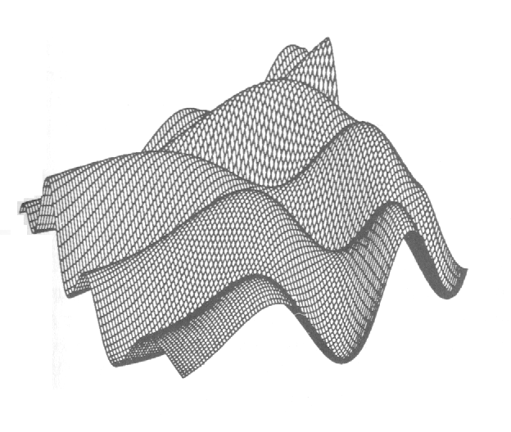
Training the Network - Learning
Backpropagation
  Requires training set (input / output pairs)
  Starts with small random weights
  Error is used to adjust weights (supervised learning)
  → Gradient descent on error landscape

Slide 13
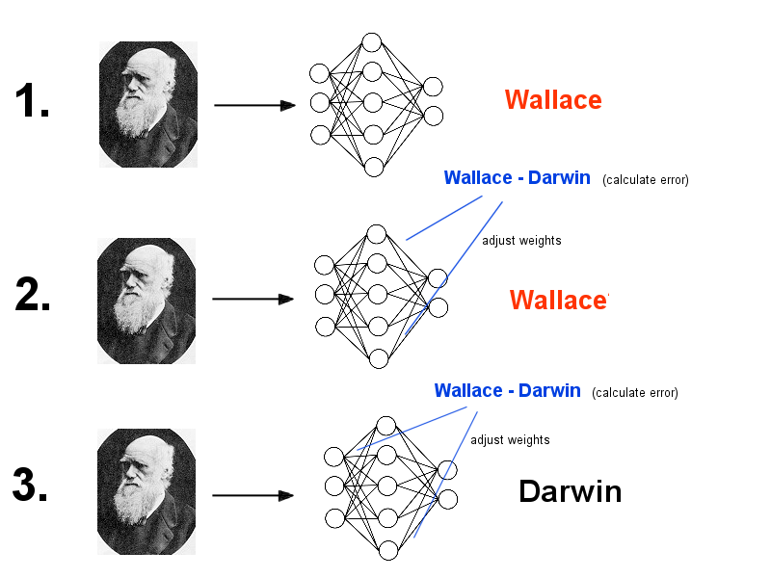

Slide 14
Advantages
  It works!
  Relatively fast
Downsides
  Requires a training set
  Can be slow
  Probably not biologically realistic
Alternatives to Backpropagation
  Hebbian learning
    Not successful in feed-forward nets
  Reinforcement learning
    Only limited success
  Artificial evolution
    More general, but can be even slower than backprop

Slide 15
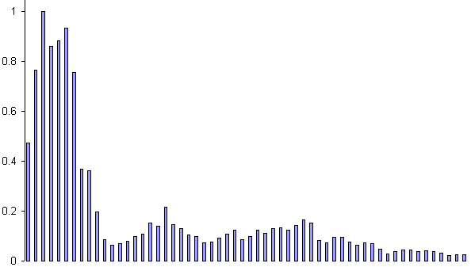
Example: Voice Recognition
Task: Learn to discriminate between two different voices saying “Hello”
Data
  Sources
    Steve Simpson
    David Raubenheimer
  Format
    Frequency distribution (60 bins)
    Analogy: cochlea

Slide 16
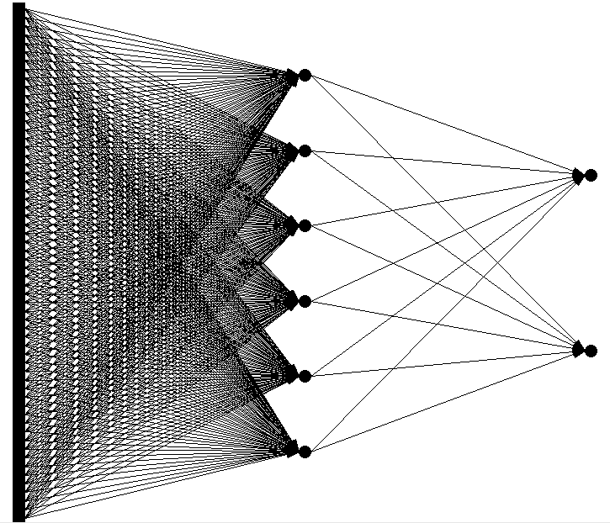
Network architecture
  Feed forward network
    60 input (one for each frequency bin)
    6 hidden
    2 output (0-1 for “Steve”, 1-0 for “David”)

Slide 17
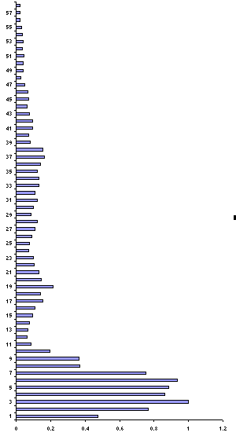
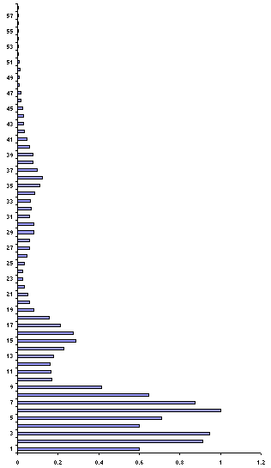
Presenting the data
Steve
David

Slide 18
Presenting the data (untrained network)
Steve
0.43
0.26
David
0.73
0.55

Slide 19
Calculate error
Steve
0.43 – 0 = 0.43
0.26 –1 = 0.74
David
0.73 – 1 = 0.27
0.55 – 0 = 0.55

Slide 20
Backprop error and adjust weights
Steve
0.43 – 0 = 0.43
0.26 – 1 = 0.74
1.17
David
0.73 – 1 = 0.27
0.55 – 0 = 0.55
0.82

Slide 21
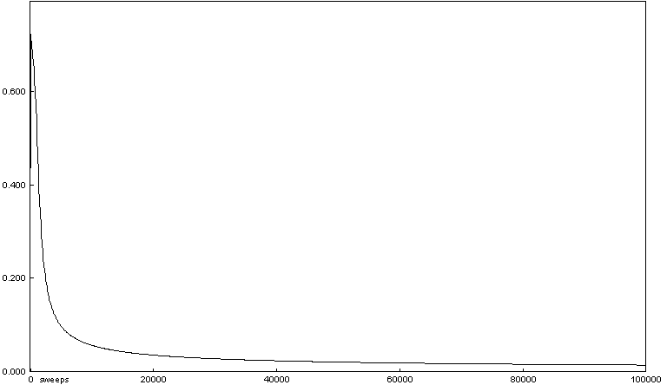
Repeat process (sweep) for all training pairs
  Present data
  Calculate error
  Backpropagate error
  Adjust weights
Repeat process multiple times

Slide 22
Presenting the data (trained network)
Steve
0.01
0.99
David
0.99
0.01

Slide 23
Results – Voice Recognition
  Performance of trained network
    Discrimination accuracy between known “Hello”s
      100%
    Discrimination accuracy between new “Hello”’s
      100%

Slide 24
Results – Voice Recognition (ctnd.)
  Network has learnt to generalise from original data
  Networks with different weight settings can have same functionality
  Trained networks ‘concentrate’ on lower frequencies
  Network is robust against non-functioning nodes

Slide 25
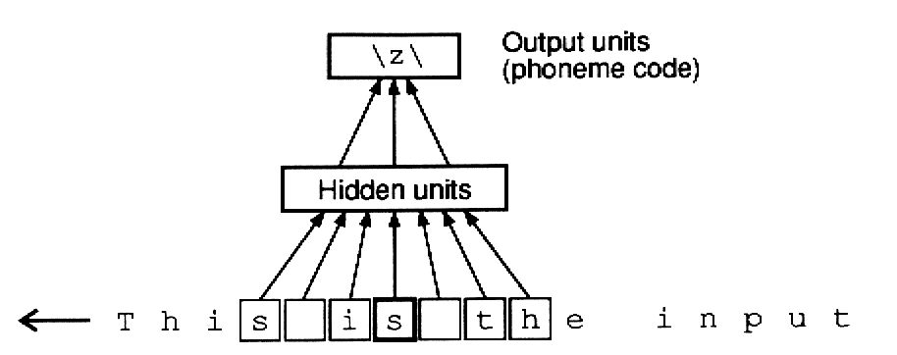
Applications of Feed-forward nets
  Pattern recognition
    Character recognition
    Face Recognition
  Sonar mine/rock recognition (Gorman & Sejnowksi, 1988)
  Navigation of a car (Pomerleau, 1989)
  Stock-market prediction
  Pronunciation (NETtalk)
  (Sejnowksi & Rosenberg, 1987)

Slide 26

Recurrent Networks
Feed forward networks:
  Information only flows one way
  One input pattern produces one output
  No sense of time (or memory of previous state)
Recurrency
  Nodes connect back to other nodes or themselves
  Information flow is multidirectional
  Sense of time and memory of previous state(s)
Biological nervous systems show high levels of recurrency (but feed-forward structures exists too)

Slide 27
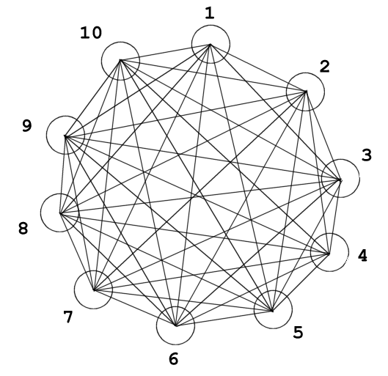
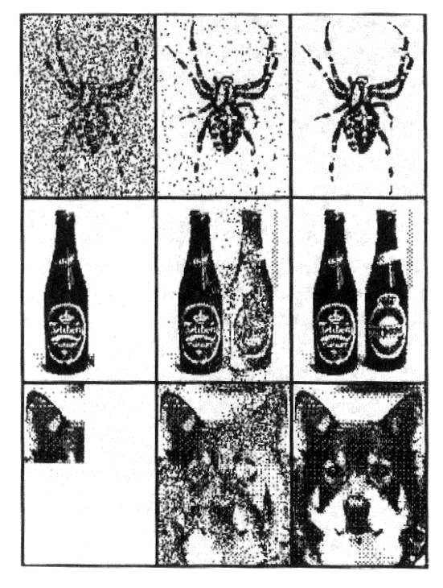
Hopfield Networks
Sub-type of recurrent neural nets
  Fully recurrent
  Weights are symmetric
  Nodes can only be on or off
  Random updating
Learning: Hebb rule (cells that fire together wire together)
  Biological equivalent to LTP and LTD
Can recall a memory, if presented with a
corrupt or incomplete version
→ auto-associative or
content-addressable memory

Slide 28
Recap – Neural Networks
Components – biological plausibility
  Neurone / node
  Synapse / weight
Feed forward networks
  Unidirectional flow of information
  Good at extracting patterns, generalisation and prediction
  Distributed representation of data
  Parallel processing of data
  Training: Backpropagation
  Not exact models, but good at demonstrating principles
Recurrent networks
  Multidirectional flow of information
  Memory / sense of time
  Complex temporal dynamics (e.g. CPGs)
  Various training methods (Hebbian, evolution)
  Often better biological models than FFNs

Slide 29
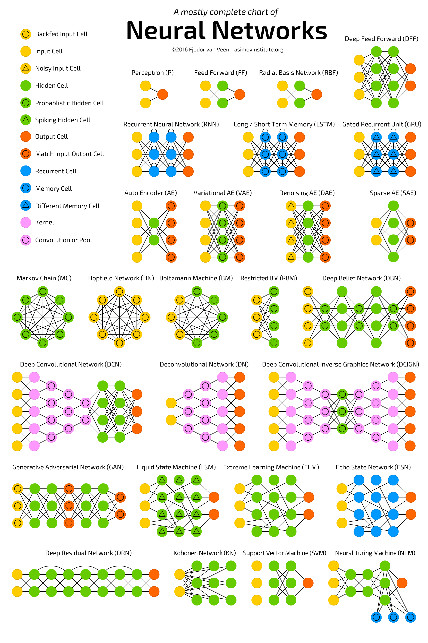
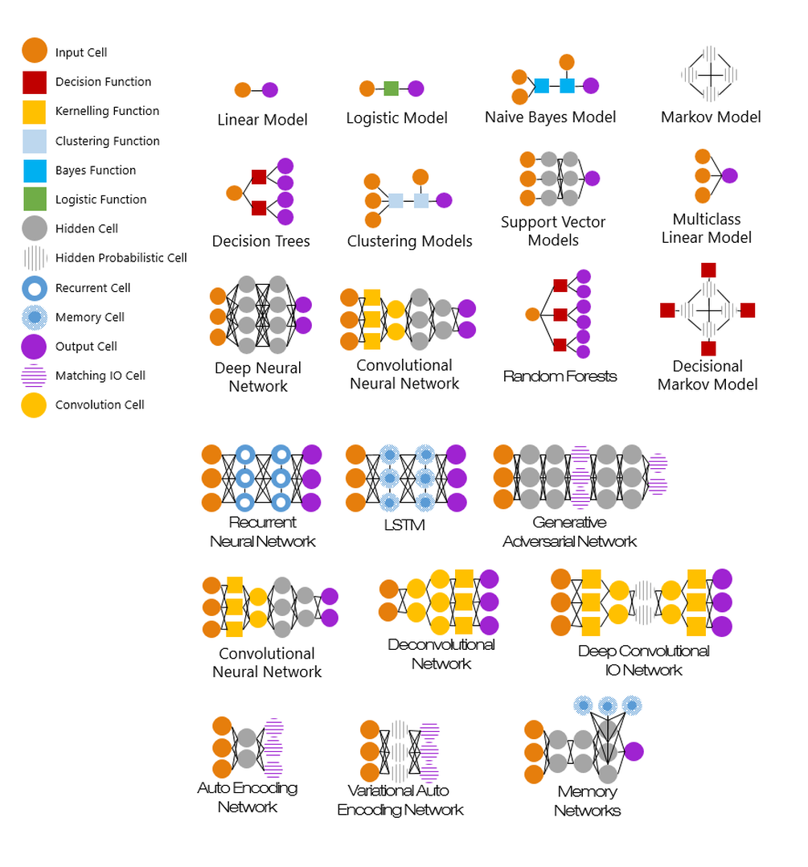
The Machine Learning Zoo

Slide 30
Backpropagation Algorithm for Learning Feedforward Multilayer Networks
Rumelhart, David E.; Hinton, Geoffrey E.; Williams, Ronald J. (8 October 1986). "Learning representations by back-propagating errors". Nature. 323 (6088): 533–536. Bibcode:1986Natur.323..533R. doi:10.1038/323533a0.

Slide 31

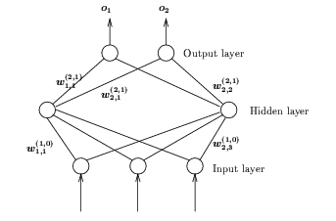
Backpropagation Learning
Architecture:
  Feedforward network of at least one layer of non-linear hidden nodes, e.g., # of layers L ≥ 2 (not counting the input layer)
  Node function is differentiable
  most common: sigmoid function
Learning: supervised, error driven,
generalized delta rule
Call this type of nets BP nets
The weight update rule
(gradient descent approach)
Practical considerations
Variations of BP nets
Applications

Slide 32
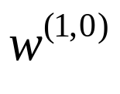
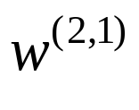
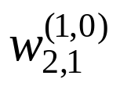

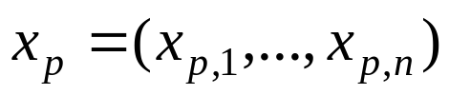


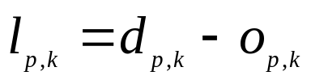
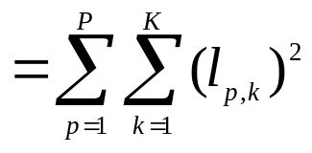
BP Learning
Notations:
  Weights: two weight matrices:
  from input layer (0) to hidden layer (1)
  from hidden layer (1) to output layer (2)
  weight from node 1 at layer 0 to node 2 in layer 1
  Training samples: pair of
  so it is supervised learning
  Input pattern:
  Output pattern:
  Desired output:
  Error: error for output node k when x_{p} is applied
  sum square error
  This error drives learning (change and )

Slide 33
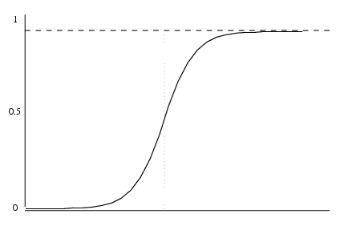
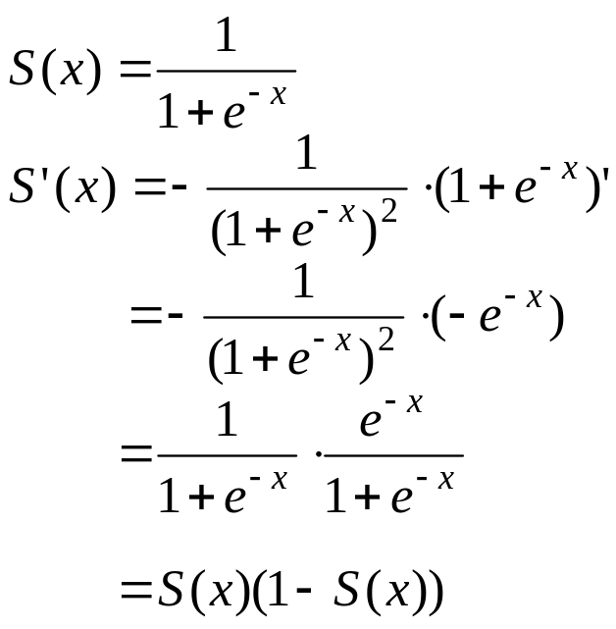
BP Learning
Sigmoid function again:
  Differentiable:
  When |net| is sufficiently large, it moves into one of the two saturation regions, behaving like a threshold or ramp function.
Chain rule of differentiation
Saturation
region
Saturation
region

Slide 34
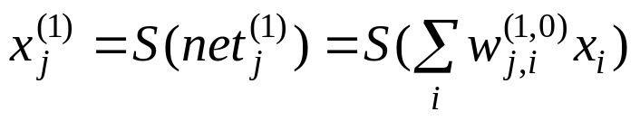
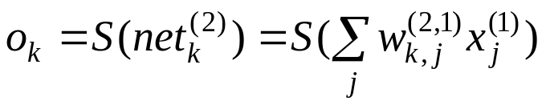
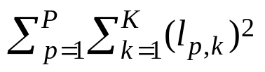
BP Learning
Forward computing:
  Apply an input vector x to input nodes
  Computing output vector x⁽¹⁾ on hidden layer
  Computing the output vector o on output layer
  The network is said to be a map from input x to output o
Objective of learning:
  Modify the 2 weight matrices to reduce sum square error
  for the given P training samples as much as possible (to zero if possible)

Slide 35
BP Learning
Idea of BP learning:
  Update of weights in w^{(2, 1)} (from hidden layer to output layer):
  delta rule as in a single layer net using sum square error
  Delta rule is not applicable to updating weights in w^{(1, 0)} (from input and hidden layer) because we don’t know the desired values for hidden nodes
  Solution: Propagating errors at output nodes down to hidden nodes, these computed errors on hidden nodes drives the update of weights in w^{(1, 0)} (again by delta rule), thus called error Back Propagation (BP) learning
  How to compute errors on hidden nodes is the key
  Error backpropagation can be continued downward if the net has more than one hidden layer
  Proposed first by Werbos (1974), current formulation by Rumelhart, Hinton, and Williams (1986)

Slide 36
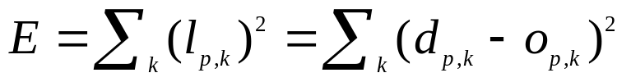
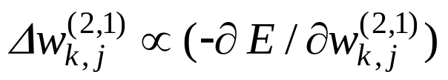
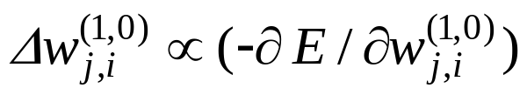

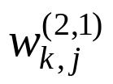
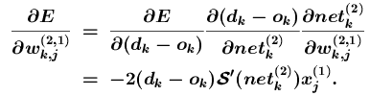
BP Learning
Generalized delta rule:
  Consider sequential learning mode: for a given sample (x_{p}, d_{p})
  Update weights by gradient descent
  For weight in w^{(2, 1)}:
  For weight in w^{(1, 0)}:
  Derivation of update rule for w^{(2, 1)}:
  since E is a function of l_{k} = d_{k} – o_{k}, o_{k} is a function of , and is a function of , by chain rule

Slide 37
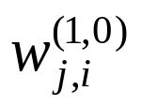
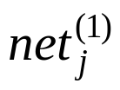
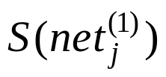
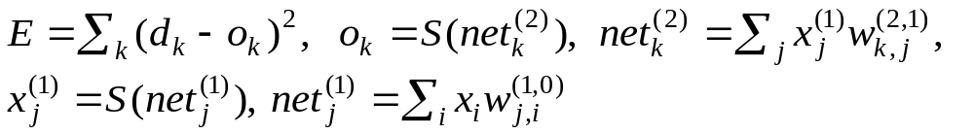
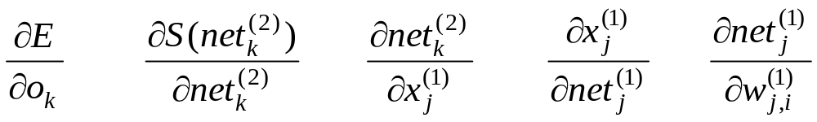

BP Learning
o_{k}
  Derivation of update rule for
  consider hidden node j:
  weight influences
  it sends to all output nodes
  ∴ all K terms in E are functions of
j
i
by chain rule

Slide 38



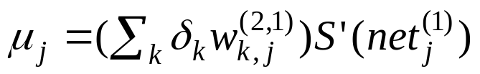

Backpropagation Learning
  Update rules:
  for outer layer weights w^{(2, 1)} :
  where
  for inner layer weights w^{(1, 0)} :
  where
Weighted sum of errors from output layer

Slide 39
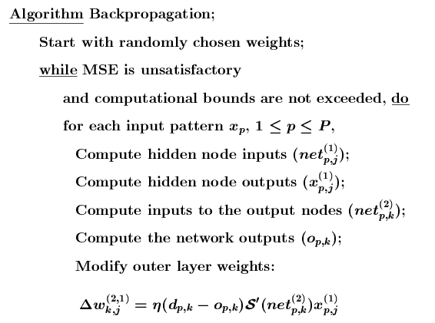
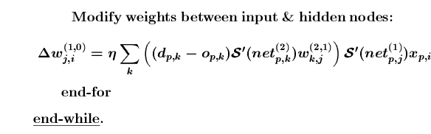
Note: if S is a logistic function, then S’(x) = S(x)(1 – S(x))

Slide 40
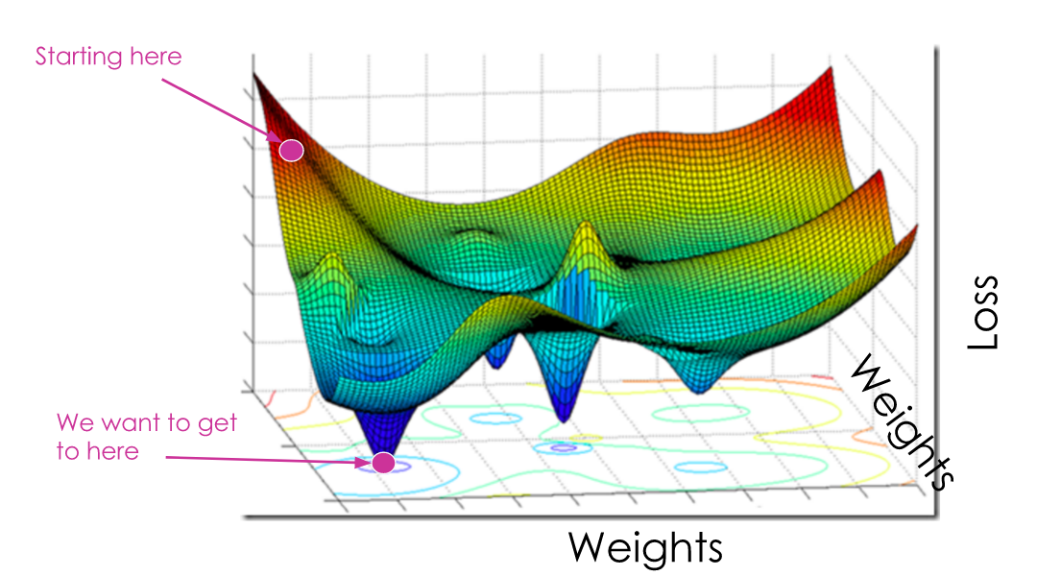
Search landscape

Slide 41
BP Learning
Pattern classification:
  Two classes: 1 output node
  N classes: binary encoding (log N) output nodes
  better using N output nodes, a class is represented as
  (0,..., 0,1, 0,.., 0)
  With sigmoid function, nodes at output layer will never be 1 or 0, but either 1 – ε or ε.
  Error reduction becomes slower when moving into saturation regions (when ε is small).
  For fast learning, for a given error bound e,
  set error l_{p,k} = 0 if |d_{p,k} – o_{p,k}| ≤ e
  When classifying a input x using a trained BP net, classify it to the k^{th} class if o_{k}. > o_{l} for all l != k

Slide 42
BP Learning
Pattern classification: an example
  Classification of myoelectric signals
    Input pattern: 2 features, normalized to real values between -1 and 1
    Output patterns: 3 classes
  Network structure: 2-5-3
    2 input nodes, 3 output nodes,
    1 hidden layer of 5 nodes
    η = 0.95, α = 0.4 (momentum)
  Error bound e = 0.05
  332 training samples (simplified from data set in Appendix B2)
  Maximum iteration = 20,000
  When stopped, 38 patterns remain misclassified

Slide 43
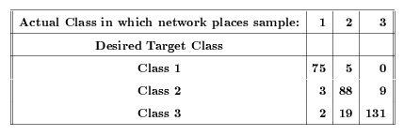
38 patterns misclassified

Slide 44
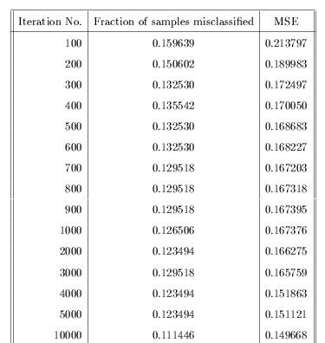


Slide 45


BP Learning
Function approximation:
  For the given w = (w^{(1, 0)}, w^{(2,1)}), o = f(x): it realizes a functional mapping from input vector x to f (x).
  Theoretically, feedforward nets with at least one hidden layer of non-linear nodes are able to approximate any L2 functions (all square-integral functions, including almost all commonly used math functions) to any given degree of accuracy, provided there are sufficient many hidden nodes
  Any L2 function f (x) can be approximated by a Fourier series
  where k is a N dim vector
  The MSE converges to 0 when N → ∞
  It has been shown the Fourier series approximation can be realized with Feedforward net with one hidden layer of cosine node function
  Reading for grad students (Sec. 3.5) for more discussions

Slide 46
Strengths of BP Learning
Great representation power
  Any L2 function can be represented by a BP net
  Many such functions can be approximated by BP learning (gradient descent approach)
Easy to apply
  Only requires that a good set of training samples is available
  Does not require substantial prior knowledge or deep understanding of the domain itself (ill structured problems)
  Tolerates noise and missing data in training samples (graceful degrading)
Easy to implement the core of the learning algorithm
Good generalization power
  Often produce accurate results for inputs outside the training set

Slide 47
Deficiencies of BP Learning
Learning often takes a long time to converge
  Complex functions often need hundreds or thousands of epochs
The network is essentially a black box
  It may provide a desired mapping between input and output vectors (x, o) but does not have the information of why a particular x is mapped to a particular o.
  It thus cannot provide an intuitive (e.g., causal) explanation for the computed result.
  This is because the hidden nodes and the learned weights do not have clear semantics.
    What can be learned are operational parameters, not general, abstract knowledge of a domain
  Unlike many statistical methods, there is no theoretically well-founded way to assess the quality of BP learning
    What is the confidence level of o computed from input x using such net?
    What is the confidence level for a trained BP net, with the final E (which may or may not be close to zero)?

Slide 48
Problem with gradient descent approach
  only guarantees to reduce the total error to a local minimum. (E might not be reduced to zero)
    Cannot escape from the local minimum error state
    Not every function that is representable can be learned
  How bad: depends on the shape of the error surface. Too many valleys/wells will make it easy to be trapped in local minima
  Possible remedies:
    Try nets with different # of hidden layers and hidden nodes (they may lead to different error surfaces, some might be better than others)
    Try different initial weights (different starting points on the surface)
    Forced escape from local minima by random perturbation (e.g., simulated annealing)

Slide 49

Generalization is not guaranteed even if the error is reduced to 0
  Over-fitting/over-training problem: trained net fits the training samples perfectly (E reduced to 0) but it does not give accurate outputs for inputs not in the training set
  Possible remedies:
    More and better samples
    Using smaller net if possible
    Using larger error bound (forced early termination)
    Introducing noise into samples
      modify (x₁,…, x_{n}) to (x₁+α₁,…, x_{n}+α_{n}) where α_{i} are small random displacements
    Cross-Validation
      leave some (~10%) samples as test data (not used for weight update)
      periodically check error on test data
      learning stops when error on test data starts to increase

Slide 50


Network paralysis with sigmoid activation function
  Saturation regions:
  Input to an node may fall into a saturation region when some of its incoming weights become very large during learning. Consequently, weights stop to change no matter how hard you try.
  Possible remedies:
    Use non-saturating activation functions
    Periodically normalize all weights

Slide 51
The learning (accuracy, speed, and generalization) is highly dependent of a set of learning parameters
  Initial weights, learning rate, # of hidden layers and # of nodes.
  Most of them can only be determined empirically (via experiments)

Slide 52



Practical Considerations
A good BP net requires more than the core of the learning algorithms. Many parameters must be carefully selected to ensure a good performance.
Although the deficiencies of BP nets cannot be completely cured, some of them can be eased by some practical means.
Initial weights (and biases)
  Random, [-0.05, 0.05], [-0.1, 0.1], [-1, 1]
    Avoid bias in weight initialization
  Normalize weights for hidden layer (w^{(1, 0)}) (Nguyen-Widrow)
    Random assign initial weights for all hidden nodes
    For each hidden node j, normalize its weight by

Slide 53
Training samples:
  Quality and quantity of training samples often determines the quality of learning results
  Samples must collectively represent well the problem space
    Random sampling
    Proportional sampling (with prior knowledge of the problem space)
  # of training patterns needed: There is no theoretically idea number.
    Baum and Haussler (1989): P = W/e, where
    W: total # of weights to be trained (depends on net structure)
    e: acceptable classification error rate
    If the net can be trained to correctly classify (1 – e/2)P of the P training samples, then classification accuracy of this net is 1 – e for input patterns drawn from the same sample space
    Example: W = 27, e = 0.05, P = 540. If we can successfully train the network to correctly classify (1 – 0.05/2)*540 = 526 of the samples, the net will work correctly 95% of time with other input.

Slide 54
How many hidden layers and hidden nodes per layer:
  Theoretically, one hidden layer (possibly with many hidden nodes) is sufficient to represent any L2 functions
  There is no theoretical results on minimum necessary # of hidden nodes
  Practical rule of thumb:
    n = # of input nodes; m = # of hidden nodes
    For binary/bipolar data: m = 2n
    For real data: m >> 2n
  Multiple hidden layers with fewer nodes may be trained faster for similar quality in some applications

Slide 55




Data representation:
  Binary vs bipolar
    Bipolar representation uses training samples more efficiently
    no learning will occur when with binary rep.
    # of patterns can be represented with n input nodes:
    binary: 2^n
    bipolar: 2^(n-1) if no biases used, this is due to (anti) symmetry
    (if output for input x is o, output for input –x will be –o )
  Real value data
    Input nodes: real value nodes (may subject to normalization)
    Hidden nodes with sigmoid or other non-linear function
    Node function for output nodes: often linear (even identity)
    e.g.,
    Training may be much slower than with binary/bipolar data (some use binary encoding of real values)

Slide 56


Variations of BP nets
Adding momentum term (to speedup learning)
  Weights update at time t+1 contains the momentum of the previous updates, e.g.,
  an exponentially weighted sum of all previous updates
  Avoid sudden change of directions of weight update (smoothing the learning process)
  Error is no longer monotonically decreasing

Slide 57
Batch mode of weight update
  Weight update once per each epoch (cumulated over all P samples)
  Smoothing the training sample outliers
  Learning independent of the order of sample presentations
  May be slower than in sequential mode

Slide 58

Variations on learning rate η
  Fixed rate much smaller than 1
  Start with large η, gradually decrease its value
  Start with a small η, steadily double it until MSE start to increase
  Give known underrepresented samples higher rates
  Find the maximum safe step size at each stage of learning (to avoid overshoot the minimum E when increasing η)
  Adaptive learning rate (delta-bar-delta method)
    Each weight w_{k,j} has its own rate η_{k,j}
    If remains in the same direction, increase η_{k,j} (E has a smooth curve in the vicinity of current w)
    If changes the direction, decrease η_{k,j} (E has a rough curve in the vicinity of current w)

Slide 59
Experimental comparison
  Training for XOR problem (batch mode)
  25 simulations with random initial weights: success if E averaged over 50 consecutive epochs is less than 0.04
  results
method | simulations | success | Mean epochs
BP | 25 | 24 | 16,859.8
BP with momentum | 25 | 25 | 2,056.3
BP with delta-bar-delta | 25 | 22 | 447.3

Slide 60



Quickprop
  If E is of paraboloid shape
  if ∂E/ ∂w changes sign from t-1 to t, then its (local) minimum is likely to lie between
  and can be determined analytically as

Slide 61



Other node functions
  Change the range of the logistic function from (0,1) to (a, b)
  Change the slope of the logistic function
    Larger slope:
    quicker to move to saturation regions; faster convergence
    Smaller slope: slow to move to saturation regions, allows refined weight adjustment
    σ thus has a effect similar to the learning rate η (but more drastic)
  Adaptive slope (each node has a learned slope)

Slide 62




  Another sigmoid function with slower saturation speed
  the derivative of logistic function
  A non-saturating function (also differentiable)

Slide 63
Applications of BP Nets
A simple example: Learning XOR
  Initial weights and other parameters
    weights: random numbers in [-0.5, 0.5]
    hidden nodes: single layer of 4 nodes (A 2-4-1 net)
    biases used;
    learning rate: 0.02
  Variations tested
    binary vs. bipolar representation
    different stop criteria
    normalizing initial weights (Nguyen-Widrow)
  Bipolar is faster than binary
    convergence: ~3000 epochs for binary, ~400 for bipolar
    Why?

Slide 64


Binary nodes
Bipolar nodes

Slide 65



  Relaxing acceptable error range may speed up convergence
    is an asymptotic limits of sigmoid function,
    When an output approaches , it falls in a saturation region
    Use
  Normalizing initial weights may also help
 | Random | Nguyen-Widrow
Binary | 2,891 | 1,935
Bipolar | 387 | 224
Bipolar with | 264 | 127

Slide 66
Data compression
  Autoassociation of patterns (vectors) with themselves using a small number of hidden nodes:
    training samples:: x:x (x has dimension n)
    hidden nodes: m < n (A n-m-n net)
    If training is successful, applying any vector x on input nodes will generate the same x on output nodes
    Pattern z on hidden layer becomes a compressed representation of x (with smaller dimension m < n)
    Application: reducing transmission cost
V
W
n
m
n
V
W
x
n
m
z
z
m
n
x
Communication
channel
sender
receiver

Slide 67
  Example: compressing character bitmaps.
    Each character is represented by a 7 by 9 pixel bitmap, or a binary vector of dimension 63
    10 characters (A – J) are used in experiment
    Error range:
    tight: 0.1 (off: 0 – 0.1; on: 0.9 – 1.0)
    loose: 0.2 (off: 0 – 0.2; on: 0.8 – 1.0)
    Relationship between # hidden nodes, error range, and convergence rate
      relaxing error range may speed up
      increasing # hidden nodes (to a point) may speed up
    error range: 0.1 hidden nodes: 10 # epochs: 400+
    error range: 0.2 hidden nodes: 10 # epochs: 200+
    error range: 0.1 hidden nodes: 20 # epochs: 180+
    error range: 0.2 hidden nodes: 20 # epochs: 90+
    no noticeable speed up when # hidden nodes increases to beyond 22

Slide 68
Other applications.
  Medical diagnosis
    Input: manifestation (symptoms, lab tests, etc.)
    Output: possible disease(s)
    Problems:
      no causal relations can be established
      hard to determine what should be included as inputs
    Currently focus on more restricted diagnostic tasks
      e.g., predict prostate cancer or hepatitis B based on standard blood test
  Process control
    Input: environmental parameters
    Output: control parameters
    Learn ill-structured control functions

Slide 69
  Stock market forecasting
    Input: financial factors (CPI, interest rate, etc.) and stock quotes of previous days (weeks)
    Output: forecast of stock prices or stock indices (e.g., S&P 500)
    Training samples: stock market data of past few years
  Consumer credit evaluation
    Input: personal financial information (income, debt, payment history, etc.)
    Output: credit rating
  And many more
  Key for successful application
    Careful design of input vector (including all important features): some domain knowledge
    Obtain good training samples: time and other cost

Slide 70

Summary of BP Nets
Architecture
  Multi-layer, feed-forward (full connection between nodes in adjacent layers, no connection within a layer)
  One or more hidden layers with non-linear activation function (most commonly used are sigmoid functions)
BP learning algorithm
  Supervised learning (samples (x_{p}, d_{p}))
  Approach: gradient descent to reduce the total error
  (why it is also called generalized delta rule)
  Error terms at output nodes
  error terms at hidden nodes (why it is called error BP)
  Ways to speed up the learning process
    Adding momentum terms
    Adaptive learning rate (delta-bar-delta)
    Quickprop
  Generalization (cross-validation test)

Slide 71
Strengths of BP learning
  Great representation power
  Wide practical applicability
  Easy to implement
  Good generalization power
Problems of BP learning
  Learning often takes a long time to converge
  The net is essentially a black box
  Gradient descent approach only guarantees a local minimum error
  Not every function that is representable can be learned
  Generalization is not guaranteed even if the error is reduced to zero
  No well-founded way to assess the quality of BP learning
  Network paralysis may occur (learning is stopped)
  Selection of learning parameters can only be done by trial-and-error
  BP learning is non-incremental (to include new training samples, the network must be re-trained with all old and new samples)

Slide 72
Acknowledgements
http://www.cmpe.boun.edu.tr/~ethem/i2ml3e
https://users.cs.fiu.edu/~taoli/class/CAP4770-F10/class08.ppt

